Slide 1
Video Annotations at MBARI
Brian Schlining

Slide 2

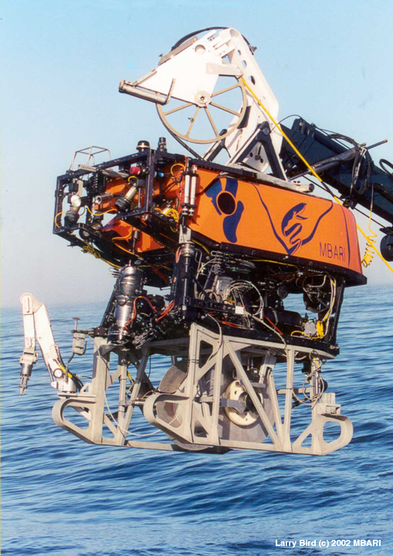
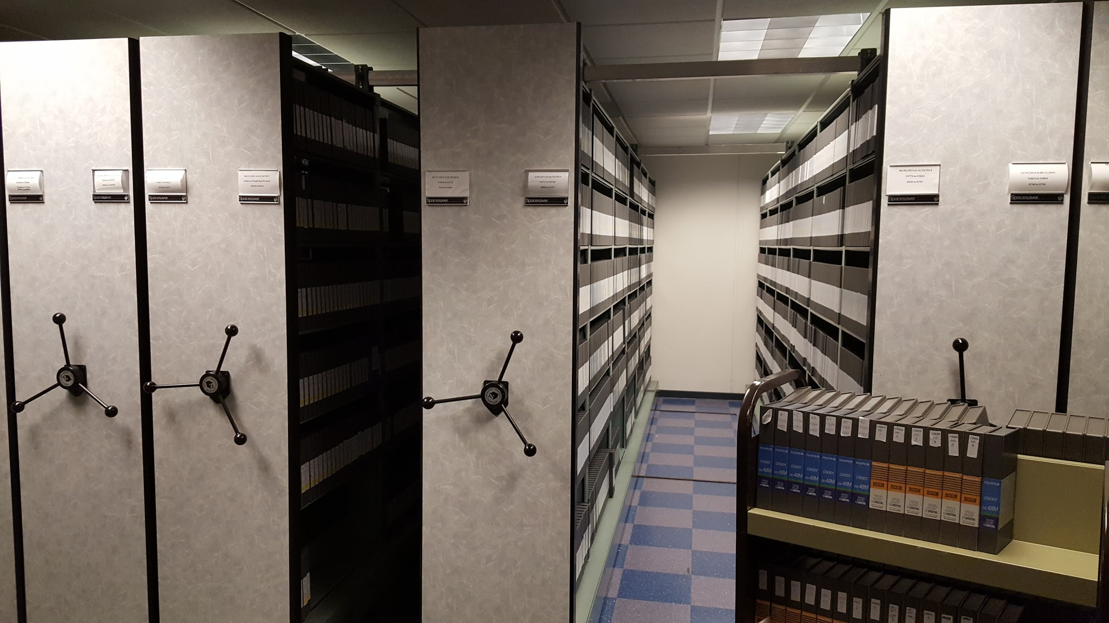
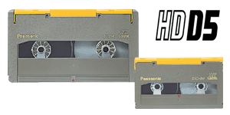
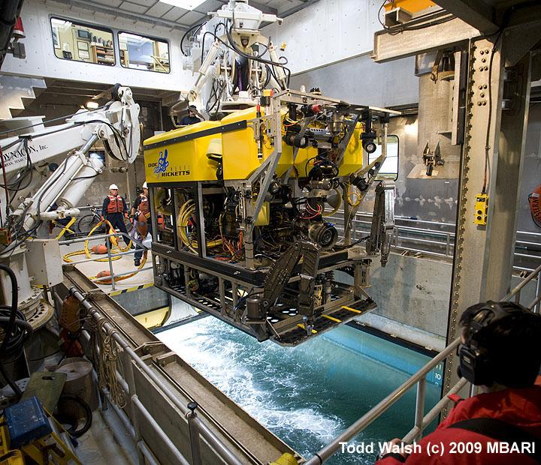
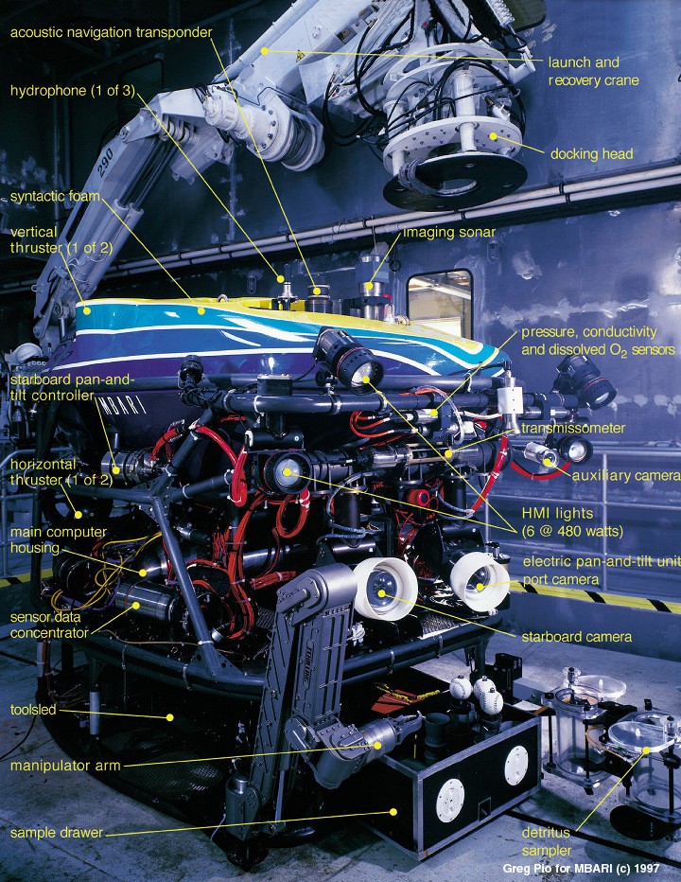
What has gone before ...
Tape
Climate-controlled storage
MBARI ROVs

Slide 3
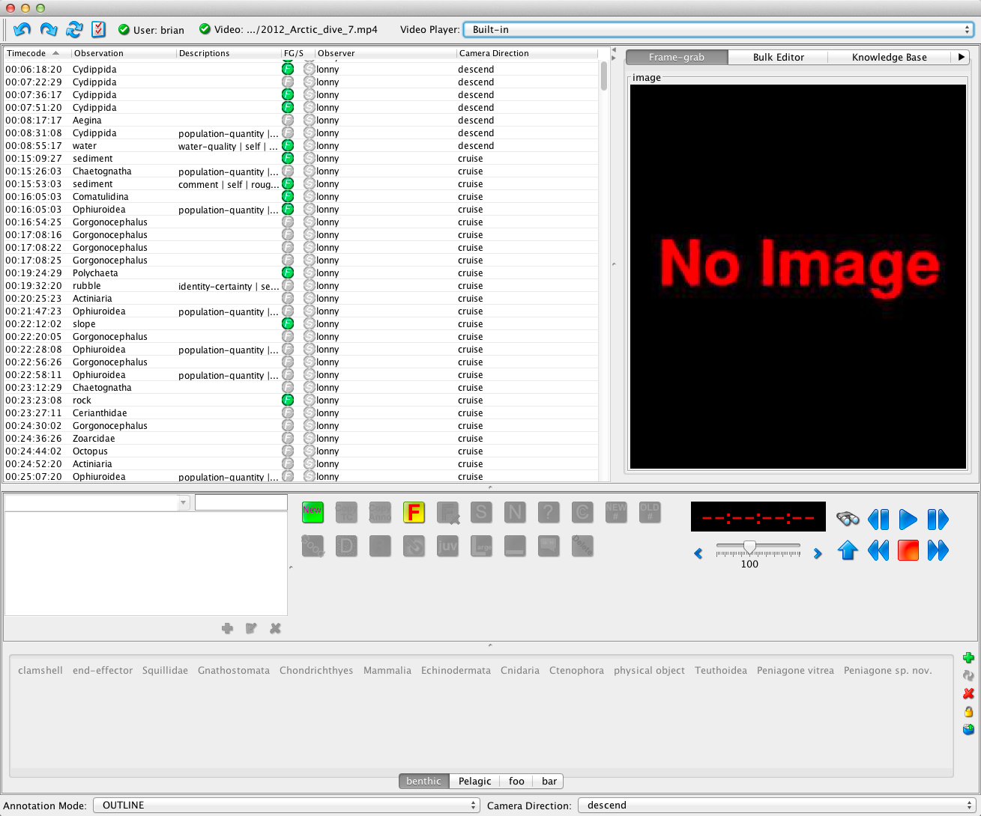

Video Annotation and Reference System (VARS)
Real-time
Database
Post-dive analysis

Slide 4
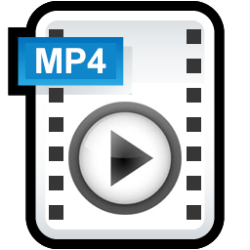


VARS works with tape, video files and images
Tape
Video Files
Image Collections

Slide 5
VARS is a multi-user system

Slide 6
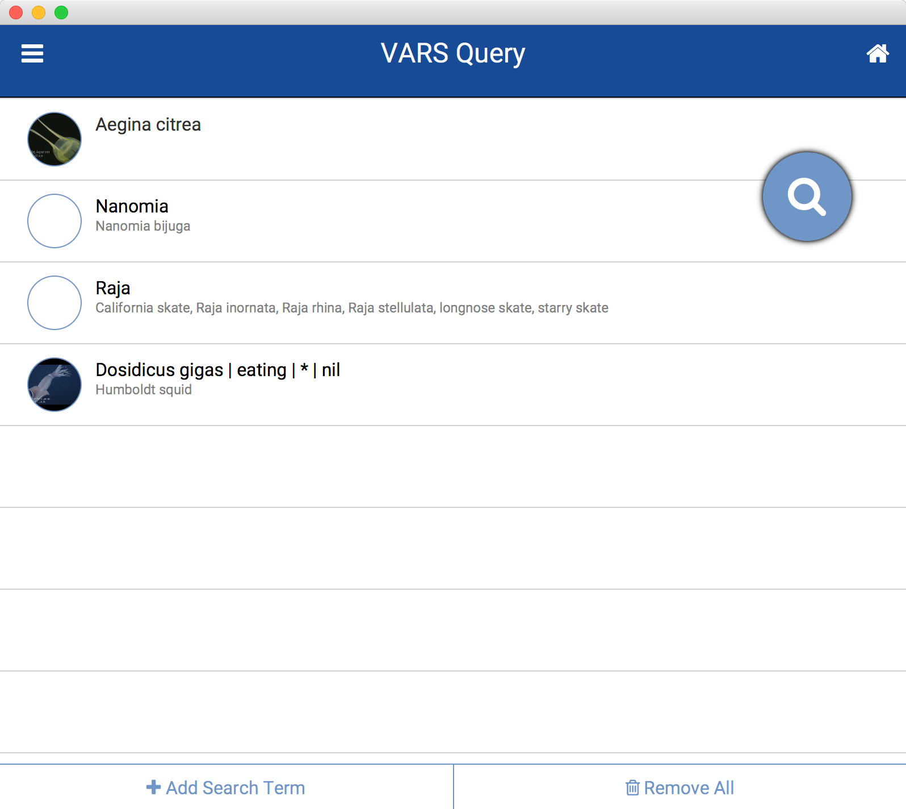
Data Output
Text Files
Images
KML
SQL
Java API

Slide 7
VARS emphasizes searchability
Annotations are constrained
No misspellings
Common names are mapped to scientific names
Allows searches by phylogenetic relationships
Other attributes can be described in flexible, but constrained manner:
Namomia | eating | Aegina | nil
Pahycara bulbiceps | upon | basalt | nil
Tomopteris | surface color | self | red
Euphausia | population-quantity | self | 127

Slide 8
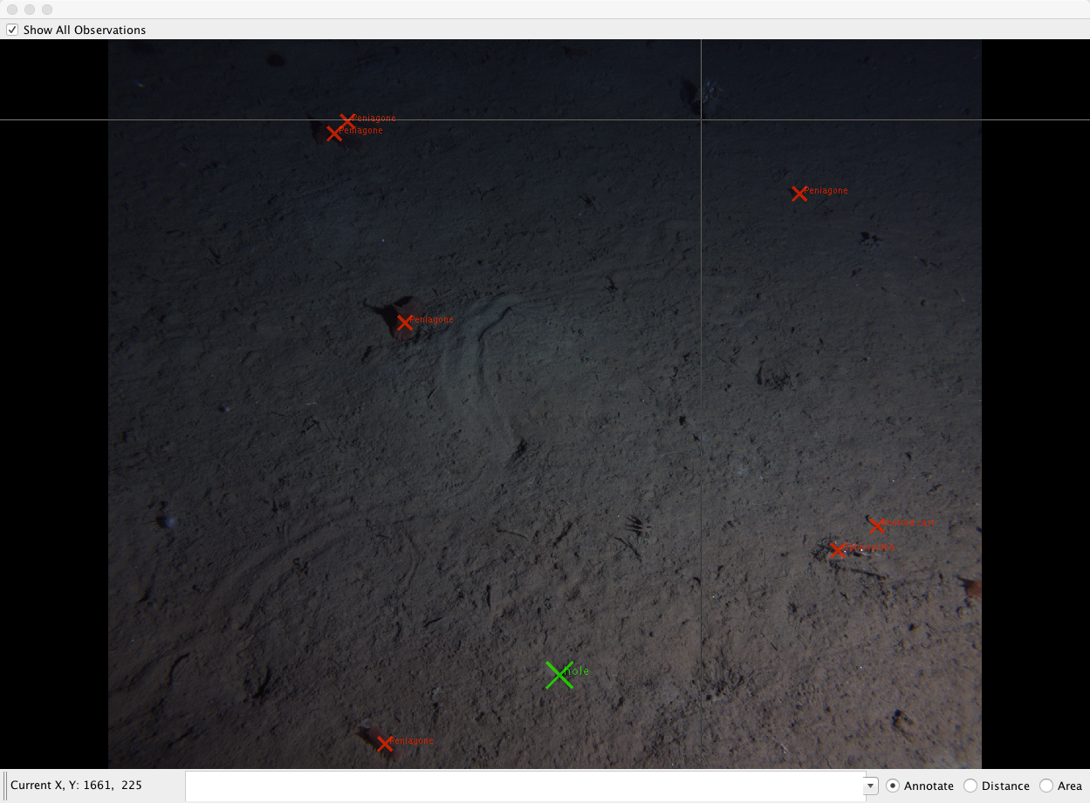
VARS supports image analysis
Annotate location

Slide 9
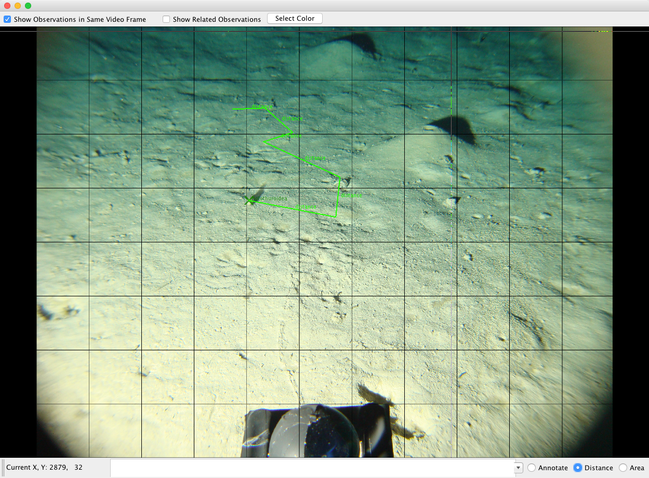
VARS supports image analysis
Distance measurements

Slide 10
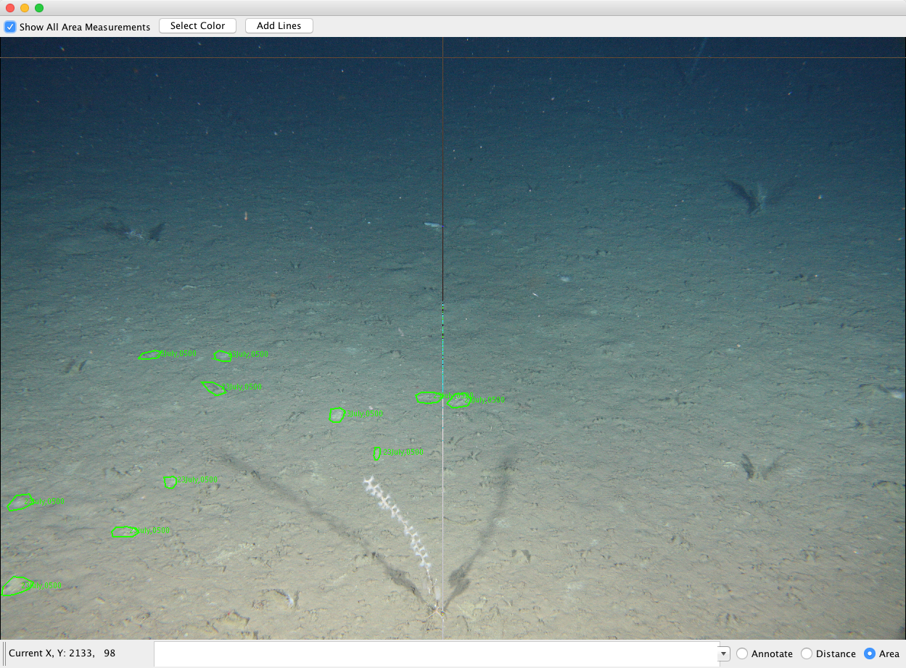
VARS supports image analysis
Area measurements

Slide 11
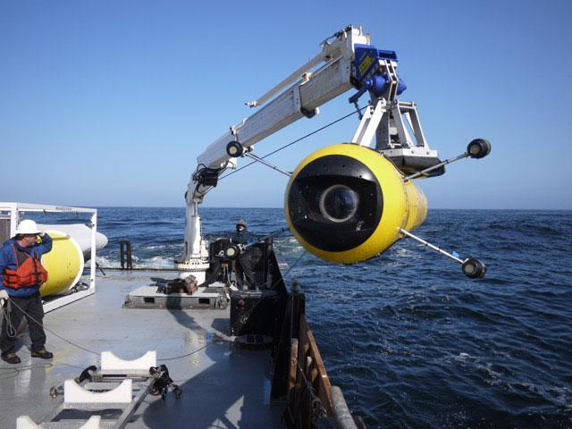
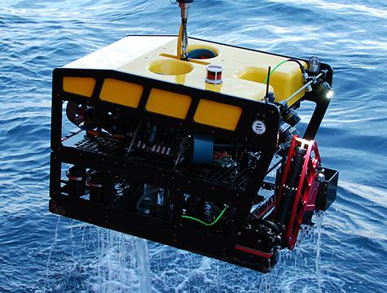
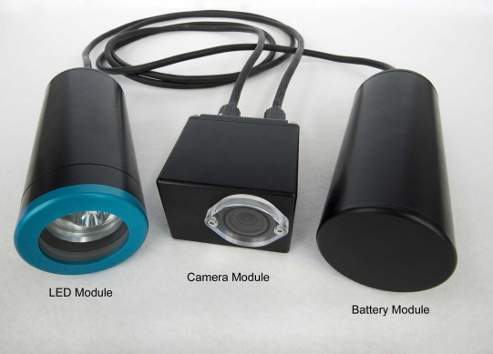
Future directions - Numerous Assets
Fly-away ROVs
AUVs
MBARI ROVs
Fixed Cameras

Slide 12
Future directions - Digital Video
X
Tape is dead

Slide 13

Future directions - Digital Video
Digital Master
Mezzanine file
Proxies
8-hour dive
15-min segments
Representations of one segment
Notes:
8 hours = 32 files. Digital Master - as close to original camera acquisition quality as you can store (e.g. ProRes). Mezzanine is lightly compressed, proxies are derived from this or digital master. Proxy are deliverables to users (easy to transport over network).

Slide 14
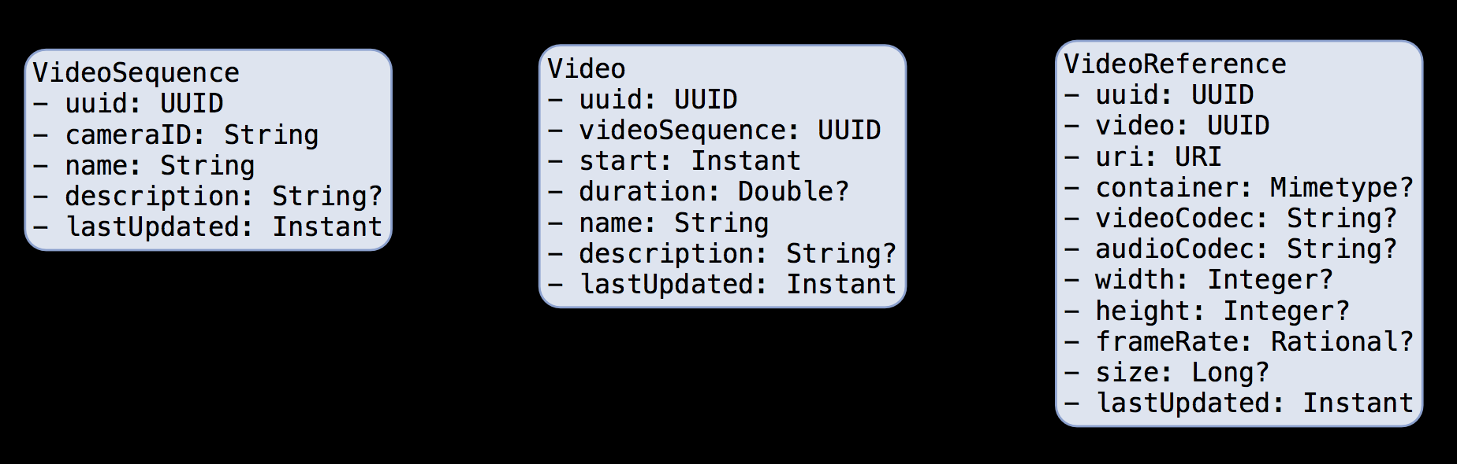
Video Metadata
Dive
Abstract Video
Concrete Video

Slide 15
Video Metadata
Locate ancillary data (position, CTD, etc.)
Locate videos of interest

Slide 16
Video Metadata
Reference to video location

Slide 17
Video Metadata
Important metadata for determining:
Which version of video is suitable for analysis
Compatibility with network/video playback app

Slide 18
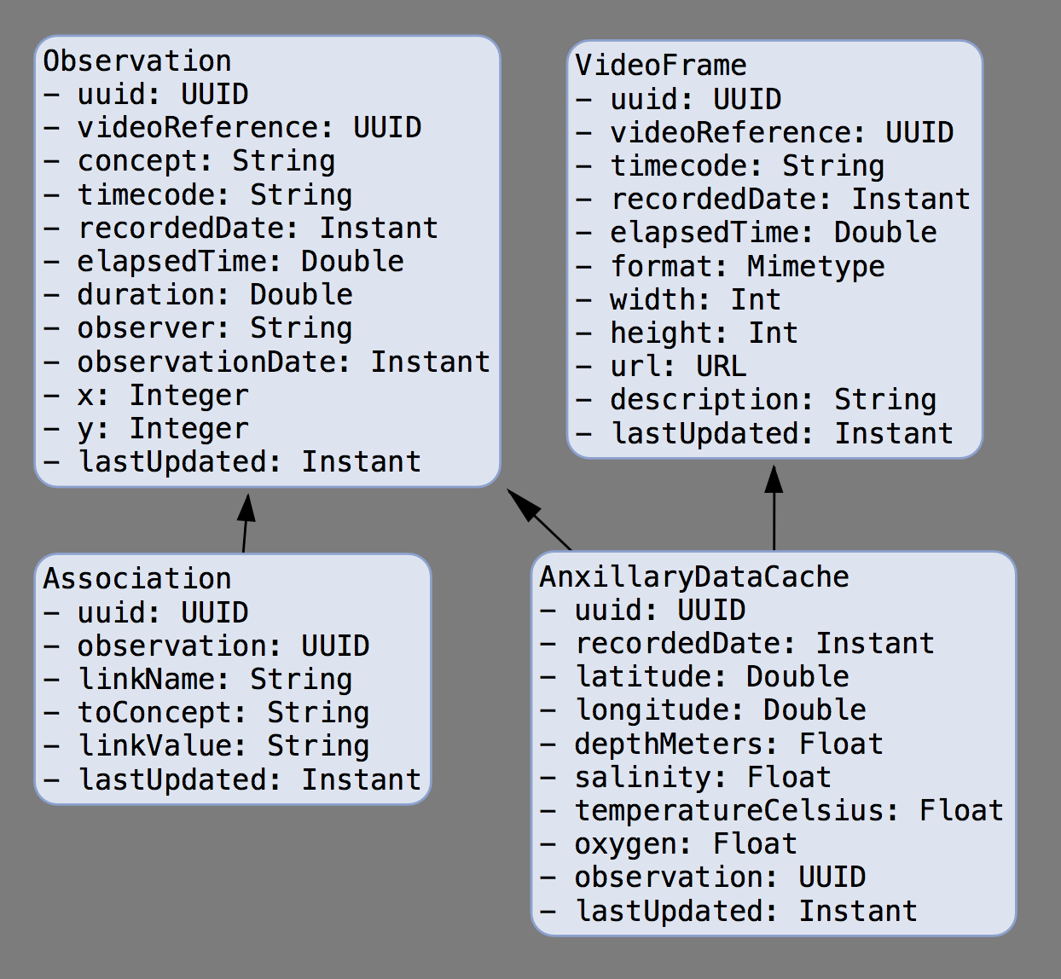
VARS Metadata
References a specific VideoReference
BUT can be related to alternate views of same video segment.

Slide 19
VARS Metadata
One or more indices into video:
Timecode (Tape/MOV)
recordedDate (real-world/real-time)
elapsedTime (video-file)

Slide 20
VARS Metadata
Cache minimal set of ancillary data for fast data lookup.

Slide 21
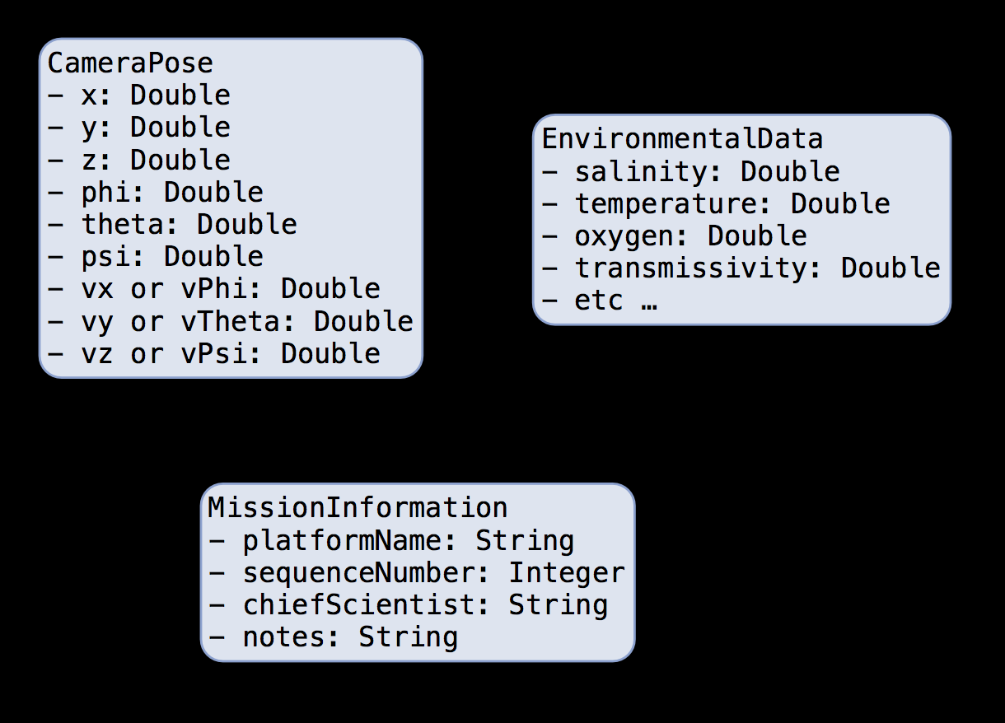
Externally Managed Metadata
Position
Orientation
Velocity
Zoom Calibration
Angular field of view
Depth of field

